Slide 1




Context-Free Languages
Regular Languages

Slide 2
前后文无关 的直观概念
括号配对 XML中mark 配对
（ （ （（ ））） ）
扫描，遇到左边括号压栈 push ,遇到右边括号弹栈，
空栈开始。 扫描完，栈空， 则配对正确。与前后文无关
只管局部行为，只看栈顶，
（
（
（
（
General idea: CFLs are languages that can be recognized by automata that have one single stack: 自动机加堆栈 （或允许栈结构的C程序可识别）
{ 0^{n}1^{n} | n≥0} is a CFL
{ 0^{n}1^{n}0^{n} | n≥0} is not a CFL（要更多的资源）
Notes:
具有递归结构特征的语言

Slide 3
Context-Free Languages
Context-Free
Grammars
Pushdown
Automata
stack
automaton

Slide 4
用前后文相关(CSL) 与 CFL 直观概念
P=“capital of china” 如何翻译？
中国的首都(北京） 或 瓷都（景德镇）
有歧义
用前后文信息 排歧
X China y → x中国y
U China v → u 瓷器 v ，
人类语言太丰富，是CSL，比较复杂 ，以后讨论。诡辩术 “断章取义” 的 语言学本质：前后相关语言中，去掉W的前后文，在W的释义集合中，选择有利于自己的意义
Algol, Pascal ,C ,…,都是CFL

Slide 5

第2章 上下文无关文法
本章内容及要求：
上下文无关文法CFG, 上下文无关的语言CFL
  Regular Language can be described by CFG (RL ⊂ CFL)
  Terminology related to CFG
    Leftmost Derivation, Ambiguity,
    Chomsky Normal Form (CNF) ,Converting a CFG into CNF
下推自动机 PDA
  An NFA equipped with a stack
  Power of CFG = Power of PDA (In terms of describing a language)
非上下文无关语言 Non-CF L
  CFL pumping lemma
  Apply pumping lemma to show that some language are non-CFL
Closure properties of CFL

Slide 6
Context-Free Grammars (Inf.)
前后文无关文法 cp63
Which simple machine produces the nonregular language { 0^{n}1^{n} | n ∈ N }?
Start symbol S with rewrite rules:
1) S → 0S1 //s从左右两边不断长出 不对称的翅膀
2) S → “stop”
S yields 0^{n}1^{n} according to
S → 0S1 → 00S11 → … → 0^{n}S1^{n} → 0^{n}1^{n}
长翅膀的规则 与 前后文无关，只管自己长, （我行我素）
比较简单，当然描述能力比较有限

Slide 7
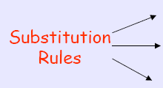
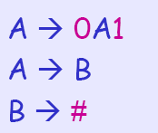
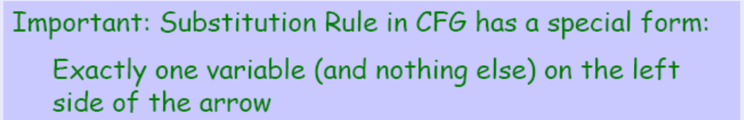
上下文无关文法CFG-Example（cp58）
起始变元
符号(变元): A,B
终结符: 输入符号，用小写字母、数字或特殊符号表示
0, 1, #
字符串(变元+终结符)
生成式：替换规则

Slide 8
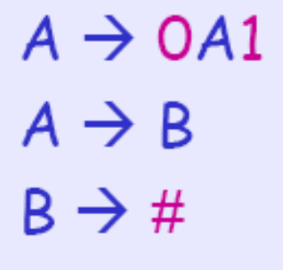
How does CFG generate strings?
Write down the start symbol
Find a variable that is written down, and a rule that starts with that variable; Then, replace the variable with the rule
Repeat the above step until no variable is left

Slide 9
How does CFG generate strings?
文法G
Step 1. A (write down the start variable)
Step 2. 0A1 (find a rule and replace)
Step 3. 00A11 (find a rule and replace)
Step 4. 00B11 (find a rule and replace)
Step 5. 00#11 (find a rule and replace)
Now, the string 00#11 does not have any variable.We can stop.

Slide 10
How does CFG generate strings?
一个文法：由一组替换规则(产生式)组成
派生：获取一个字符串的替换序列称做派生。
E.g., A derivation of the string 000#111 in the previous grammar is
The same information can be represented pictorially by a parse tree (see the next slide)

Slide 11
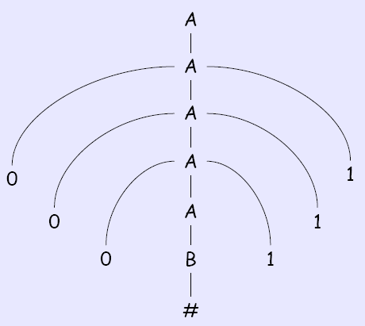
How does CFG generate strings?
parse tree:

Slide 12
Derivation ⇒* 派生，生成， ep94, cp61
A single step derivation “⇒” consist of the
substitution of a variable by a string according
to a substitution rule. 一步派生
Example: with the rule “A→BB”, we can have
the derivation “01AB0 ⇒ 01BBB0”.
A sequence of several derivations (None derivation)
is indicated by “ ⇒* ” 多步派生（0步或多步）
Same example: “0AA ⇒* 0BBBB”

Slide 13


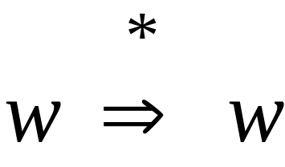
In general we write:
If:
in zero or more derivation steps
Trivially:

Slide 14
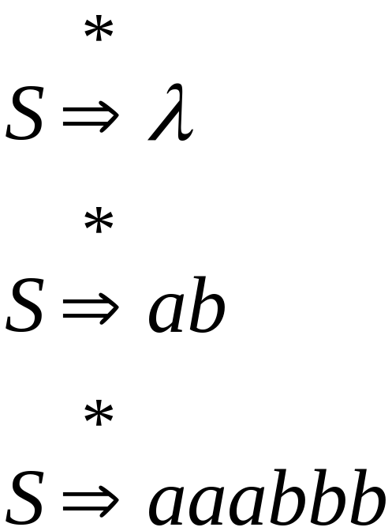

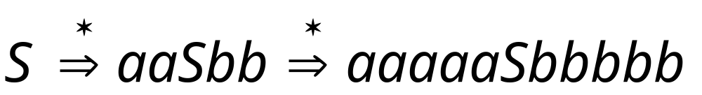
Example Grammar
Possible Derivations

Slide 15
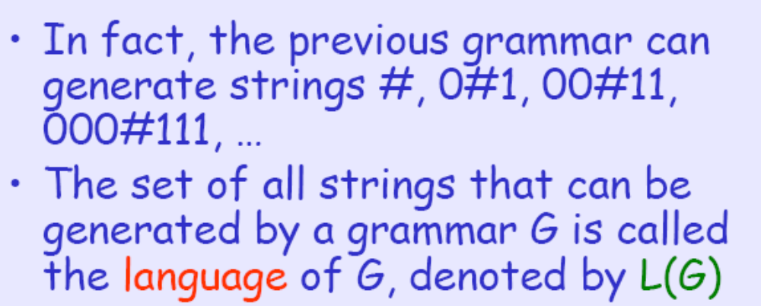
Language of the Grammar
根据文法所派生的字符串构成了该文法的语言L(G)。
The Language of the previous grammar is
L(G)={0^{n}#1^{n}|n≥0}

Slide 16

Grammars
Grammars express languages
Example: the English language grammar

Slide 17
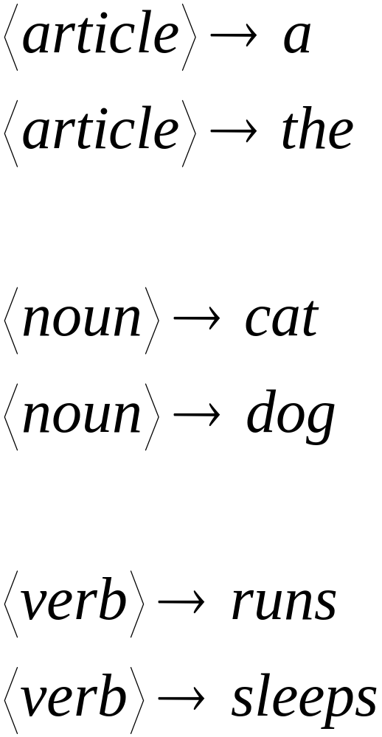

Slide 18
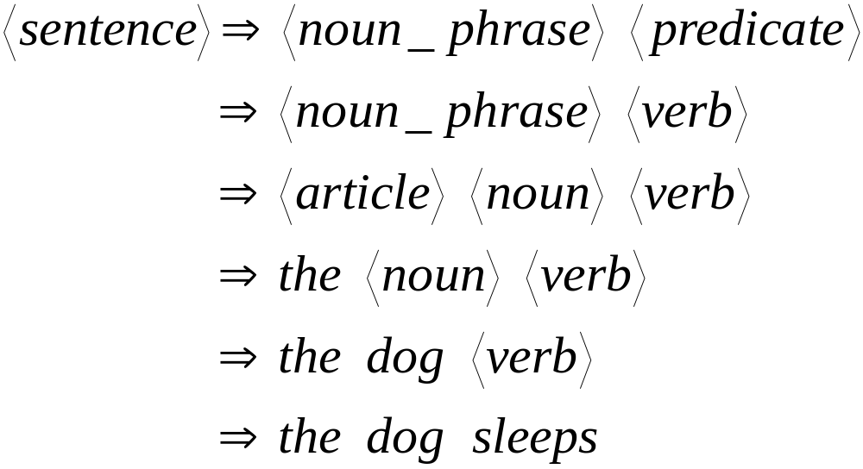
Derivation of string “the dog sleeps”:

Slide 19
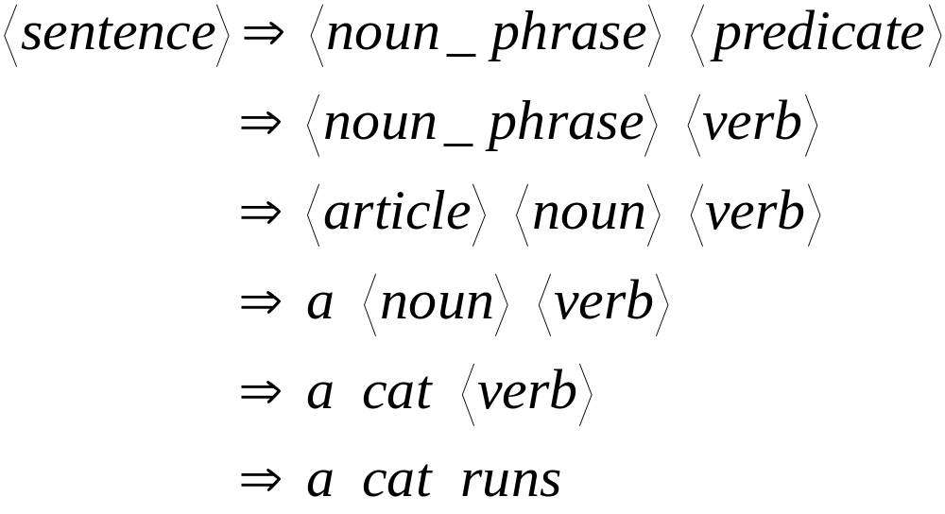
Derivation of string “a cat runs”:

Slide 20
Language of the grammar:
L = { “a cat runs”,
“a cat sleeps”,
“the cat runs”,
“the cat sleeps”,
“a dog runs”,
“a dog sleeps”,
“the dog runs”,
“the dog sleeps” }

Slide 21
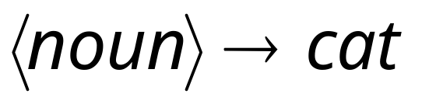
Productions
Sequence of
Terminals (symbols)
Variables
Sequence of Variables

Slide 22
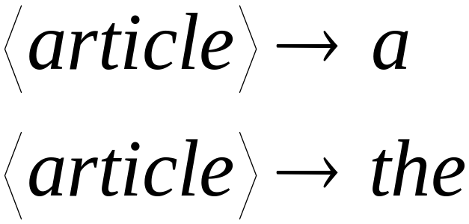
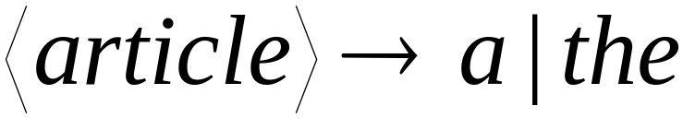
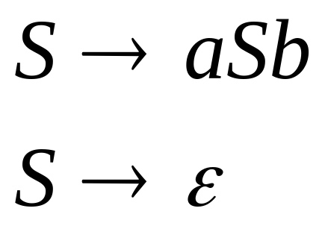
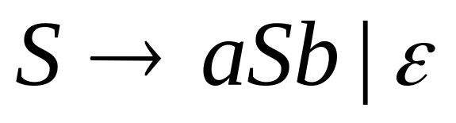
Another convenient notation:

Slide 23
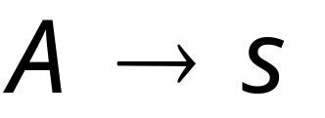
Context-Free Grammars (Def.2.1) ep94
A context free grammar G=(V,Σ,R,S) is defined by
V: a finite set variables （变元集）
Σ: finite set terminals (with V∩Σ=∅) //终极符, 字母
R: finite set of substitution rules V → (V∪Σ)*
规则是 左一右多， 或 一分为多
S: start symbol ∈V //开始符号，句子sentence
String of variables and terminals
Variable
Notes:
R is a set of substitution rules, where each rule consists of a variable (left side of the arrow) and a string of variables and terminals (right side of the arrow)

Slide 24
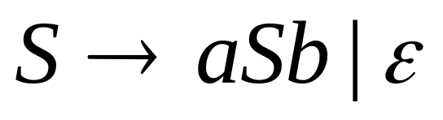
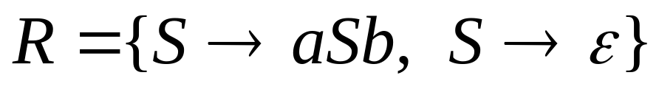
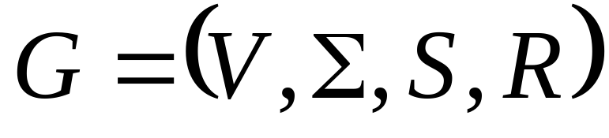


Example of Context-Free Grammar
productions
start variable
variables
terminals
Notes:
Unless stated otherwise: topmost rule concerns
the start variable 最上面一个规则头 默认为开始元素

Slide 25




Language of a Grammar:
For a grammar with start variable
String of terminals or
Notes:
80466178

Slide 26
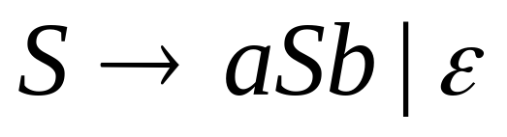
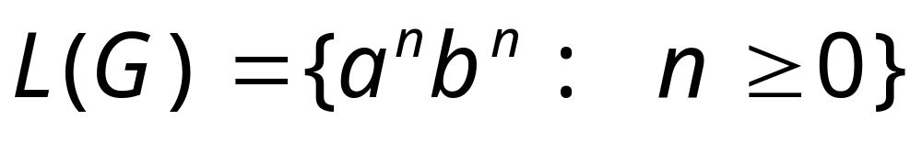
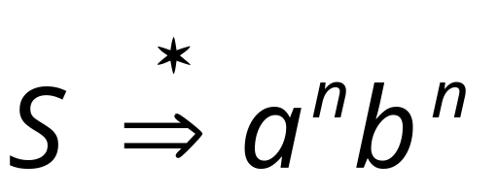
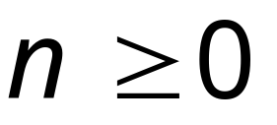
Example:
context-free grammar :
Since, there is derivation
for any

Slide 27

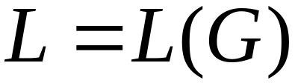
Context-Free Language:
A language is context-free
if there is a context-free grammar
with

Slide 28
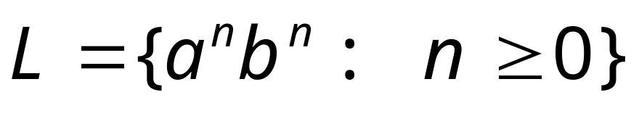

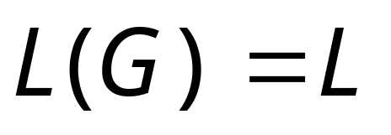
Example:
is a context-free language
since context-free grammar :
generates

Slide 29
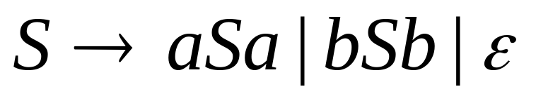


Another Example
Context-free grammar :
Example derivations:
Palindromes of even length

Slide 30
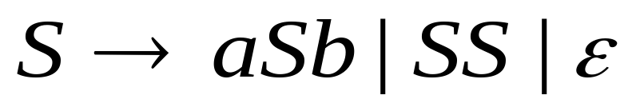
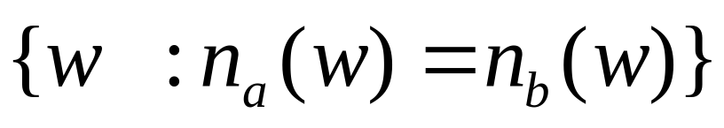

Another Example
Context-free grammar :
Example derivations:
Describes
matched
parentheses:
() ((( ))) (( ))

Slide 31
Context-Free Grammars (Ex.)
例c3.2 稍有不同 ep95 , cp61 书上例子自学
Consider the CFG G=(V,Σ,R,S) with
V = {S，Z}
Σ = {0,1}
R: S → 0S1 | 0Z1 // 两边长翅膀 | S→Z
Z → 0Z | ε // 左边长翅膀。右边不长 | 变空字
Then L(G) = {0^{i}1^{j} | i≥j }
S yields 0^{j+k}1^{j} according to:
S ⇒ 0S1 ⇒ … ⇒ 0^{j}S1^{j} ⇒ 0^{j}Z1^{j} ⇒ 0^{j}0Z1^{j} ⇒
… ⇒ 0^{j+k}Z1^{j} ⇒ 0^{j+k}ε1^{j} = 0^{j+k}1^{j}

Slide 32
Example Boolean Algebra 补充例
有两个字符，有与、或、非，刚好等价于 布尔代数
Consider the CFG G=(V,Σ,R,S) with
V = {S}
Σ = {0,1,(,),¬,∨,∧}
R: S → 0 | 1 | ¬(S) | (S)∨(S) | (S)∧(S)
Some elements of L(G):
0
¬((¬(0))∨(1))
(1)∨((0)∧(0))
Note: Parentheses prevent “1∨0∧0” confusion.

Slide 33
Parse Trees ep 93，书上无此图，类似于cp65
The parse tree of (0)∨((0)∧(1)) via rule
S → 0 | 1 | ¬(S) | (S)∨(S) | (S)∧(S):
S
(
S
)
∨
(
)
S
0
(
S
)
∧
(
S
)
0
1

Slide 34
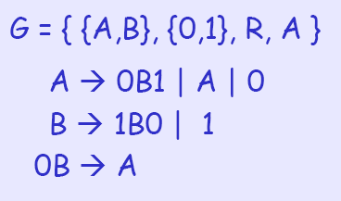
Quick Quiz
Is the following a CFG?

Slide 35
Regular Language and
Context Free Language
Prof. Busch - LSU

Slide 36
RL ⊆ CFL 命题 : 正则语言是CFL
Every regular language can be expressed by
a context-free grammar.
Proof Idea: RL →DFA→造CFG,使得结果一样
Given a DFA M = (Q,Σ,δ,q₀,F), we construct a
corresponding CF grammar G_{M} = (V,Σ,R,S)
with V = Q and S = q₀ （始符对应DFA始态）
Rules of G_{M}: CFG的规则对应于自动机的边
q_{i} → x δ(q_{i},x) for all q_{i}∈V and all x∈Σ
q_{i} → ε for all q_{i}∈F（终止态）
下页有例子
Notes:
Then, we can show that the above CFG generates exactly the same language as D (how to show?)

Slide 37
Example RL ⊆ CFL 边 对应于 规则
0
1
The DFA
leads to the
context-free grammar
G_{M} = (Q,Σ,R,q₁) with the rules
q₁ → 0q₁ q1 → 1q₂
q₂ → 0q₃ | 1q₂ | ε
q₃ → 0q₂ | 1q₂
1
0
q₁
q₂
q₃
0,1

Slide 38
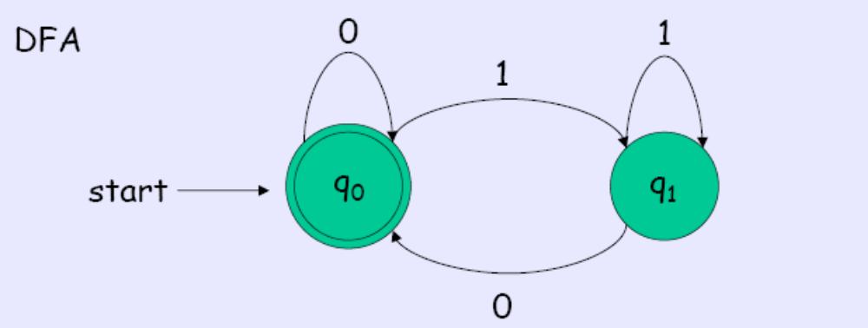
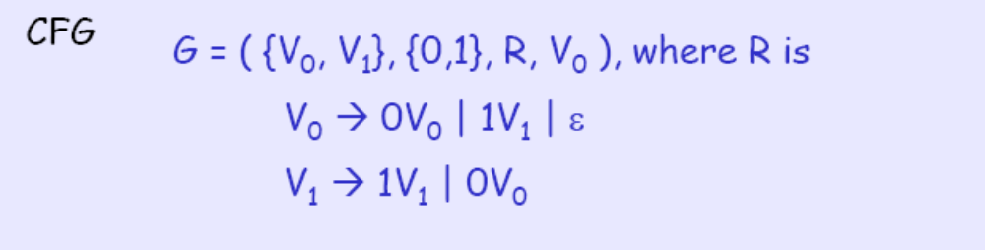
Example RL ⊆ CFL Example

Slide 39
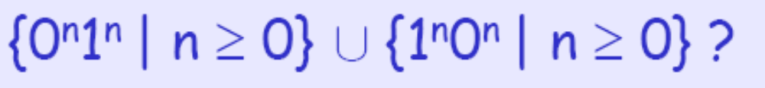
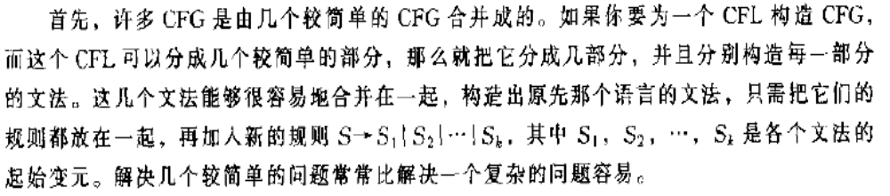
Designing CFG
Can we design CFG for
•Do we know CFG for {0^{n}1^{n} | n ≥0}?
•Do we know CFG for {1^{n}0^{n} | n ≥ 0}?

Slide 40
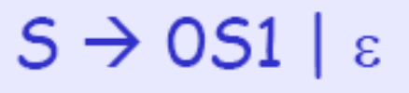

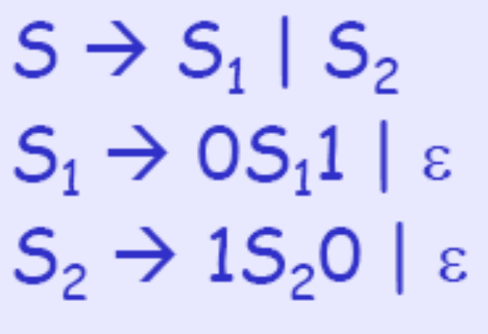
Designing CFG
Can we design CFG for L1={0^{n}1^{n} | n ≥0}?
Can we design CFG for L2={1^{n}0^{n} | n ≥0}?
Can we design CFG for L1∪ L2

Slide 41
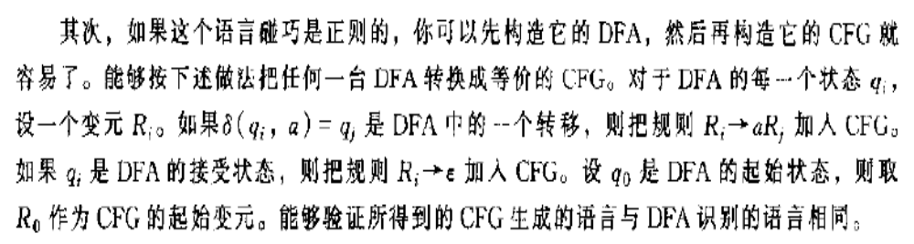
Designing CFG

Slide 42
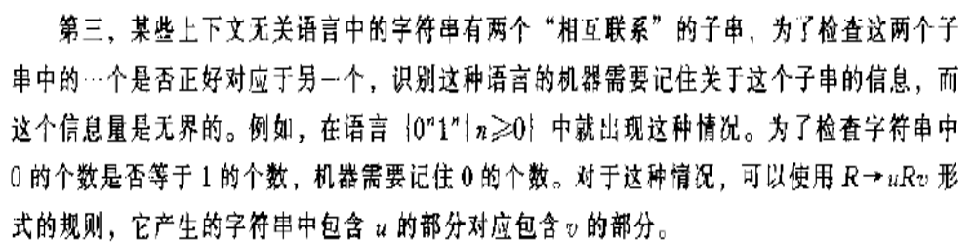
Designing CFG

Slide 43


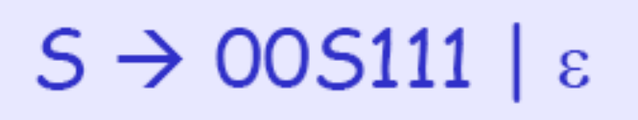
Designing CFG

Slide 44
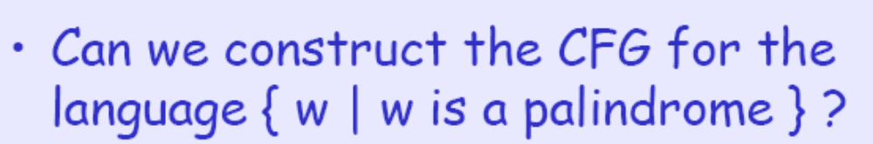
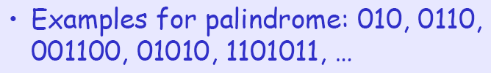
Designing CFG
S → 0S0 | 1S1 | 0 | 1 | ε

Slide 45
Derivation Order and
Derivation Trees

Slide 46
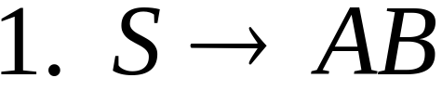
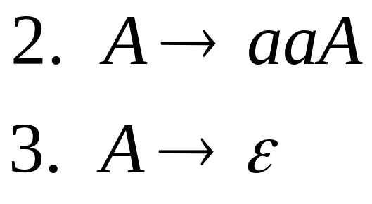
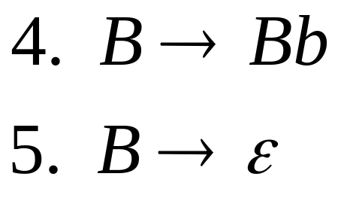
Derivation Order
Consider the following example grammar
with 5 productions:

Slide 47
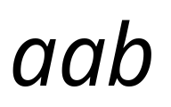

Leftmost derivation order of string :
At each step, we substitute the
leftmost variable

Slide 48

Rightmost derivation order of string :
At each step, we substitute the
rightmost variable

Slide 49
Leftmost derivation of :
Rightmost derivation of :

Slide 50

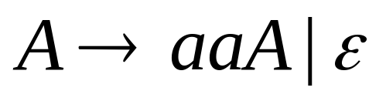
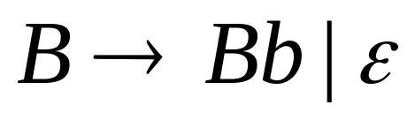
Derivation Trees
Consider the same example grammar:
And a derivation of :

Slide 51




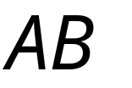
yield

Slide 52



yield

Slide 53


yield

Slide 54


yield

Slide 55


Derivation Tree
(parse tree)
yield

Slide 56

Sometimes, derivation order doesn’t matter
Leftmost derivation:
Rightmost derivation:
Give same
derivation tree

Slide 57
Ambiguity
ep97 cp65
I saw that girl with telescope
(人分辨时 要看前后文）

Slide 58

Grammar for mathematical expressions
Example strings:
Denotes any number

Slide 59





A leftmost derivation
for

Slide 60

Another
leftmost derivation
for

Slide 61
Two derivation trees
for

Slide 62



take

Slide 63





Good Tree
Bad Tree
Compute expression result
using the tree

Slide 64
Two different derivation trees
may cause problems in applications which
use the derivation trees:
Evaluating expressions
In general, in compilers
for programming languages

Slide 65
More on Ambiguity
Some programming languages have ambiguous grammars; in this case, semantic information is needed to select the intended parse of an ambiguous construct. For example, in C the following
x * y;
Can be interpreted as the declaration of an identifier y of type pointer to x;
or as an expression in which x is multiplied by y and the result is discarded.
To choose between the two possible interpretations, a compiler must consult its symbol table to find out whether x has been declared as a typedef name that is visible at this point.

Slide 66
Observation: Ambiguity ep97 cp65
I saw that girl with telescope (人分辨时 要看前后文）
A string is derived ambiguously if it has more than one leftmost derivations. 有多个最左派生，一个派生是一个确切语义
A grammar is ambiguous if some strings
are derived ambiguously. 歧义,
Note that the two leftmost derivations in
the previous example correspond to different parse trees
–In fact, each leftmost derivation corresponds
to a unique parse tree

Slide 67

Ambiguous Grammar:
A context-free grammar is ambiguous
if there is a string which has:
two different derivation trees
or
two leftmost derivations
(Two different derivation trees give two
different leftmost derivations and vice-versa)

Slide 68
Example:
this grammar is ambiguous since
string
has two derivation trees

Slide 69
this grammar is ambiguous also because
string
has two leftmost derivations

Slide 70

Another ambiguous grammar:
IF_STMT
if EXPR then STMT
if EXPR then STMT else STMT
Variables
Terminals
Very common piece of grammar
in programming languages

Slide 71
If expr1 then if expr2 then stmt1 else stmt2
IF_STMT
if
expr1
then
STMT
if
expr2
then
stmt1
else
stmt2
Two derivation trees
IF_STMT
if
expr1
then
STMT
else
stmt2
if
expr2
then
stmt1

Slide 72
In general, ambiguity is bad
and we want to remove it
Sometimes it is possible to find
a non-ambiguous grammar for a language
But, in general we cannot do so

Slide 73

More on Ambiguity (Examples)
CFG: A → A + A | A − A | a
is ambiguous since there are 2 leftmost derivations for the string a+a-a:
 | A | → A + A |  | A | → A - A
 |  | → a + A |  |  | → A + A - A
 |  | → a + A - A |  |  | → a + A - A
 |  | → a + a - A |  |  | → a + a - A
 |  | → a + a - a |  |  | → a + a - a
a) The grammar is ambiguous since there are two parse trees for the string a + a − a;
b) The language that it generates, however, is not inherently ambiguous; the following is a non-ambiguous grammar generating the same language:
A → A + a | A − a | a
Notes:
Recognizing an ambiguous grammar
The general question of whether a grammar is not ambiguous is undecidable. No algorithm can exist to determine the ambiguity of a grammar because the undecidable Post correspondence problem can be encoded as an ambiguity problem.
There is an obvious difficulty in parsing an ambiguous grammar by a deterministic parser (see deterministic context-free grammar) but nondeterministic parsing imposes a great efficiency penalty. Most constructs of interest to parsing can be recognized by unambiguous grammars. Some ambiguous grammars can be converted into unambiguous grammars, but no general procedure for doing this is possible just as no algorithm exists for detecting ambiguous grammars. Compiler generators such as YACC include features for disambiguating some kinds of ambiguity, such as by using the precedence and associativity constraints.

Slide 74
Removing Ambiguity
There is NO algorithm that can tell whether a CFG is ambiguous.
There are techniques for eliminating ambiguity:
  Adding non-terminals or dividing the variables into factors, terms, and expressions.
Removing Ambiguity from a + b * c
Notes:
表达式expression. 项 term. 因子 factor

Slide 75


A successful example:
Equivalent
Ambiguous
Grammar
Non-Ambiguous
Grammar
generates the same
language

Slide 76




Unique
derivation tree
for

Slide 77

Removing Ambiguity from a + a * a
Grammar 1:
  E->E+E|E*E|a|b|c
Grammar:
  I -> a|b|c
  F -> I|(E)
  T -> F|T * F
  E -> T|E + T
Terms (T) cannot be broken by the + operator.
A factor (F) cannot be broken by a + or a *.
I’s are identifiers
E’s are expressions

Slide 78



An un-successful example:
is inherently ambiguous:
every grammar that generates this
language is ambiguous

Slide 79




Example (ambiguous) grammar for :

Slide 80




The string
has always two different derivation trees
(for any grammar)
For example

Slide 81


Fun Fact: Inherently Ambiguous
判定任给 CFG G 是否为二义性的问题是一个不可解的(unsolvable)问题。

Slide 82
Example of an Inherently Ambiguous CFL
L = {a^{n}b^{n}c^{m}d^{m} | n>=1, m>=1} U {a^{n}b^{m}c^{m}d^{n} | n>=1, m>=1}
Thus,
  There are as many a’s as b’s and as many c’s as d’s, or
  There are as many a’s as d’s and as many b’s as c’s.

Slide 83
A Grammar for L
L = {a^{n}b^{n}c^{m}d^{m} | n>=1, m>=1} U {a^{n}b^{m}c^{m}d^{n} | n>=1, m>=1}
S -> AB | C
A -> aAb | ab
B -> cBd | cd
C -> aCd | aDd
D -> bDc | bc

Slide 84
Leftmost Derivations for L with string aabbccdd
S -> AB | C
A -> aAb | ab
B -> cBd | cd
C -> aCd | aDd
D -> bDc | bc
S => AB => aAbB => aabbB => aabbcBd => aabbccdd
S => C => aCd => aaDdd => aabDcdd => aabbccdd

Slide 85

Parse Trees for aabbccdd

Slide 86
Proving Inherent Ambiguity
The previous parse trees and leftmost derivations prove that language L has at least some ambiguous grammars.
This doesn’t prove that all of L’s grammars are ambiguous, so we don’t know if L is ambiguous.

Slide 87
Proof Idea
We argue that all but a finite number of the strings, whose counts of the four symbols a, b, c, d are all equal, must be generated in two different ways:
  a’s and b’s are equal and c’s and d’s are equal
  a’s and d’s are equal and b’s and c’s are equal
Notes:
** The proof for showing that L must be ambiguous is complex. Therefore I will only show the proof idea, and how inherent ambiguity is proved.

Slide 88
Proof Idea Continued
The only way to generate strings where a’s and b’s are equal is with a variable like A.
Variations can occur, but we must follow the mechanism for generating a’s in a way that matches the b’s.
This idea carries for the variables B, C, and D.
This argument will show that no matter what modifications we make to the basic grammar, it will generate at least some of the strings of the form a^{n}b^{n}c^{n}d^{n}.
Following this proof idea will show that L is inherently ambiguous, because no matter how the grammar is changed, it will remain ambiguous.

Slide 89
Summary
Ambiguity can cause problems in programming applications, yet sometimes ambiguity can be removed.
If all the grammars of a context-free language are ambiguous, then that language is ambiguous.
A CFL can be proved ambiguous by showing that all the grammars generated by the CFL fall into certain categories.
Notes:
Pt 3. If all those categories result in ambiguous CFG’s then the language is ambiguous.

Slide 90
例题
1) Are the following languages regular? Prove it.
[The relevant alphabet is given between brackets.]
{ a^{n} | n=2^{j} with j∈N } [ Σ = {a} ]
解：
{ n+2 | n in binary and n=2^{j} with j∈N } [ Σ = {0,1} ]
解
{ a^{n}b^{m} | n≠m and n,m∈N } [ Σ = {a,b} ]
解
下页解答

Slide 91
例题
N=1,2,4,8,….
1) Are the following languages regular? Prove it.
[The relevant alphabet is given between brackets.]
L={ a^{n} | n=2^{j} with j∈N } [ Σ = {a} ]
解：不是RL
甚至不是CFL 用pumping定理 ,….
试验： 想造一语法识别L：
S→a, ,S→A, A→BB, B→AA, B→a ， A→a
但是 它 能派生出a, aa, aaa,. 而 aaa 不在 L中。
要点: 直观地：一分为三后，中间打圈部分（y^{i})，长度是等
差级数增长，而不是指数地增长。i足够大时，就暴露出差距
引理： 正则语言中含子语言，其串长度为等差级数

Slide 92
例题
1) Are the following languages regular? Prove it.
[The relevant alphabet is given between brackets.]
{ n+2 | n in binary and n=2^{j} with j∈N } [ Σ = {0,1} ]
解
原集合为（二进制） {11,100,110,1010,10010,…}
下列自动机识别红色部分。而{11,100}有限集合，为RL,总之，是RL,是CFL
0
1
1
0
q₁
q₂
q₃
q₄

Slide 93
例题
1) Are the following languages regular? Prove it.
[The relevant alphabet is given between brackets.]
L1= { a^{n}b^{m} | n≠m and n,m∈N } [ Σ = {a,b} ]
解 L2 ={ a^{n}b^{m} | n,m∈N } 是RL
L3 ={ a^{n}b^{m} |n=m n,m∈N } 不是RL
L2 – L1=L3 如果L1是RL 则 L3也是RL 矛盾
S->N|M
N->aNb|A
A->aA|a
M->aMb|B
B->Bb|b
L3 （ L1的补集合）

Slide 94

Any Questions?

